Slide 1
A Biblical Look at Stewardship
Pastor Chick Lane

Slide 2
What does “stewardship” mean?
For most people, “stewardship” is a code word.
For most congregation members, it is code for “What the congregation does to get some of my money out of my pocket and into the offering plate.” (and my job is to give just enough to not feel guilty)
For most congregations, it is code for “Those things we have to do to get enough money to pay the bills.” (and we know how well we have done at year end when we know if we have enough money to pay all the bills)

Slide 3
What does “stewardship” mean?
Until we “crack the code” (“smash the code”?) and stop connecting stewardship with paying the bills,
There is no hope for financial stewardship to become a part of a Christian’s walk with Jesus
We are dooming ourselves to long faces every fall

Slide 4
The #1 Stewardship Resource regardless of your ministry setting
The Bible
What does it say about stewardship?

Slide 5
It all belongs to God.

Slide 6
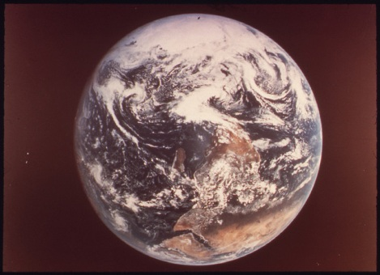

Slide 7
God is the creator and owner of all that is.
Psalm 24:1-2
The earth is the LORD’s and all that is in it,
the world, and those who live in it;
for he has founded it on the seas,
and established it on the rivers.

Slide 8
Psalm 89:11
The heavens are yours, the earth also is yours;
the world and all that is in it--you have founded
them.

Slide 10
Morning Prayer
“Into your hands we commend ourselves: our bodies, our souls, and all that is ours.”
“Into your hands we commend ourselves: our bodies, our souls, and all that is yours.”

Slide 11
It all belongs to God.
We are stewards.

Slide 12
We are stewards.
I Corinthians 4:1-2
Think of us in this way, as servants of Christ and stewards of God’s mysteries. Moreover, it is required of stewards that they be found trustworthy.

Slide 13
We are stewards.
I Peter 4:10
Like good stewards of the manifold grace of God, serve one another with whatever gift each of you has received.

Slide 14
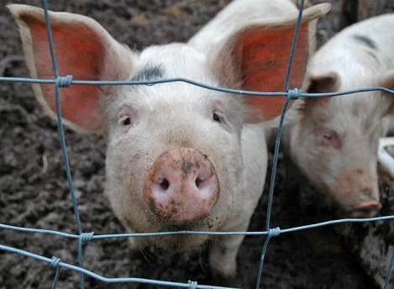
Sty warden – the keeper of the sty.

Slide 15
Steward – a most important and prestigious role
Genesis 39:1-6a
Now Joseph was taken down to Egypt, and Potiphar, an officer of Pharaoh…bought him. The Lord was with Joseph…. His master saw that the Lord was with him, and that the Lord caused all that he did to prosper in his hands. …He made him overseer in his house and over all that he had.

Slide 16
Steward – a most important and prestigious role
God thinks so highly of you that God has chosen to entrust some of what God owns into
your care
your management
your stewardship

Slide 17
It all belongs to God.
We are stewards.

Slide 18
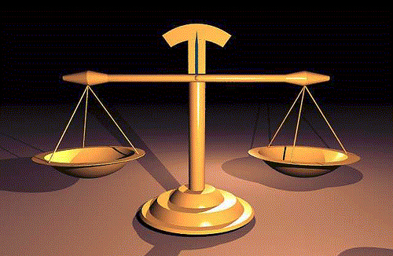
Justice issues around money

Slide 19
Justice issues around money
How you earn money
The duty and delight of generous living

Slide 20
How you earn money
Exodus 22:21-23:12 (portions)
If you lend money to my people, to the poor among you, you shall not deal with them as a creditor; you shall not exact interest from them….
You shall not pervert the justice due to your poor in their lawsuits….
You shall not oppress a resident alien
John Wesley – “The Use of Money”
Gain all you can without hurting yourself, your family, or your neighbor. (Then save all you can. Then give all you can.)

Slide 21
The duty and delight of generous living
I Timothy 6:17-19
As for those who in the present age are rich, command them not to be haughty, or to set their hopes on the uncertainty of riches, but rather on God who richly provides us with everything for our enjoyment. They are to do good, to be rich in good works, generous, and ready to share, thus storing up for themselves the treasure of a good foundation for the future, so that they may take hold of the life that really is life.

Slide 22
The duty and delight of generous living
II Corinthians 9:6-8
The point is this: the one who sows sparingly will also reap sparingly, and the one who sows bountifully will also reap bountifully. Each of you must give as you have made up your mind, not reluctantly or under compulsion, for God loves a cheerful giver. And God is able to provide you with every blessing in abundance, so that by always having enough of everything, you may share abundantly in every good work.

Slide 23
The threat of money
Matthew 6:24
No one can serve two masters; for a slave will either hate the one and love the other, or be devoted to the one and despise the other. You cannot serve God and wealth.

Slide 24
The threat of money is the power it can
exert in our lives.
“For where your treasure is, there your heart will be also.” -- Luke 12:34

Slide 25
Where your money goes will cause your heart to go there as well.

Slide 26
What does “stewardship” mean?
When the bible talks about financial stewardship,
It never talks about getting enough money to pay the bills.
It always talks about how important it is for a child of God to align her/his financial life with her/his life in Christ.

Slide 27
What does “stewardship” mean?
For most people, “stewardship” is a code word.
For most congregation members, it is code for “What the congregation does to get some of my money out of my pocket and into the offering plate.” (and my job is to give just enough to not feel guilty)
For most congregations, it is code for “Those things we have to do to get enough money to pay the bills.” (and we know how well we have done at year end when we know if we have enough money to pay all the bills)

Slide 28
The most important thing you can do in stewardship ministry is to move the money conversation…
From “Paying the Bills”
To helping people connect faith and finances in their lives.

Slide 29
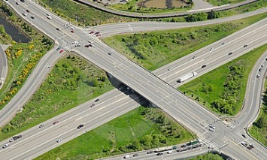
What are you doing to help people improve
the intersection of faith and finances in
their lives?

